Slide 1

Adversarial Attacks and Data Poisoning in Machine Learning
School of Computer Science and Engineering
Department of Computer Science and Engineering
Submitted By: AARNA GUPTA
2427030695
Supervised By: DR. NEHA JANU

Slide 2



Outline
Introduction
Literature Review
Problem Statement
Proposed Solution
Objectives

Slide 3
Introduction
Adversarial Attacks are Subtle manipulations of input data that mislead AI models into making wrong predictions.
Data Poisoning refers to inserting malicious or misleading samples into the training dataset to degrade model performance.
Threatens critical applications like facial recognition, autonomous driving, and malware detection.
Exposes vulnerabilities in AI systems due to their statistical and data-driven nature.
Highlights the need for robust and resilient AI models that can detect and resist such manipulations.

Slide 4
Introduction
AI and ML systems are now embedded in critical domains — from healthcare and finance to self-driving vehicles and cybersecurity. Even minor manipulations in input data can cause major errors in prediction or decision-making. Attackers exploit the data-driven nature of AI to cause system failures or gain unauthorized access.
Examples: Slightly modified traffic signs misleading autonomous cars. Poisoned datasets making malware detectors ignore new threats.

Slide 5
Literature Review
Author & Year | Methods | Focus Area | Limitations
Vassilev, Oprea, Fordyce, Anderson, Davies, Hamin | Comprehensive taxonomy; attack classification (stage, goals, knowledge); mitigations: adversarial training | Taxonomy of adversarial ML attacks & defenses. | Conceptual; empirical defenses; lacks formal benchmarks; evolving threats.
Bena, Anisetti, Damiani, Yeun, Ardagna | Risk-based ensemble: assigns poisoning risk using indicators of poisoning IoPs (SVM, kNN, centroids), routes data via round-robin/sink strategy. | Defending against data poisoning using risk-aware ensembles. | Evaluated on small tabular datasets; limited generalization to deep learning.
Pawlicki, Pawlicka, Kozik, Choraś | Meta-survey (systematic review) of papers; categorization of deep-learning models and performance metrics; gap analysis. | Survey of adversarial attacks and detection in DL models. | Inconsistent paper selection; missing standard metrics; lacks structure.

Slide 6
Literature Review
Author & Year | Methods | Focus Area | Limitations
Ndayipfukamiye, Ding, Sarwatt, Philipo, Ning | PRISMA-based review; GAN taxonomy (defensive function, architecture, threat model). | GAN-based methods for cyber threat detection and mitigation. | GANs costly, unstable, and lack standardized benchmarks.
Lakera Team | Survey of poisoning vectors and supply-chain risks; tools: PoisonBench, MCPTox. | Data poisoning in generative AI pipelines. | Poisoning detection & recovery immature; stealthy attacks impactful.
Muthalagu, Malik, Pawar | Adversarial training & abstract interpretation; mixture of attacks for malware detection robustness. | Robust ML for malware evasion defense. | Dependent on adversarial sample quality; complex; dataset-sensitive.

Slide 7
Problem Statement
Vulnerabilities of AI Models to Adversarial Attacks and Data Poisoning
Machine learning models rely heavily on large and diverse datasets for training.
Attackers can manipulate these datasets or model inputs to intentionally cause incorrect predictions or degraded performance.
Such manipulations pose serious risks to critical applications — e.g., facial recognition, autonomous vehicles, healthcare, and cybersecurity.
Adversarial manipulations can bypass traditional AI defenses and persistently weaken system security.
Minimal contamination (as little as 0.001% poisoned data) can cause significant shifts in model behavior.

Slide 8
COMPARATIVE STUDY
Attack Type | Main Idea | Domain | Pros | Cons | Current defences
Gradient-based (FGSM) | Uses model gradients to craft adversarial examples | Vision, NLP, GNN | Fast, simple, highly studied | Less effective against advanced defences | Adversarial training, PGD-based training, smoothing, input transformations
Data Poisoning | Injects malicious data into training set | Vision, Tabular, Security | Effective, hard to detect during training | Requires access to training phase, setup | Data sanitization, anomaly detection, risk-based ensemble
Score-based | Uses output confidence scores to guide attack | APIs, deployed models | No model access needed | Needs many output queries | output rounding, query monitoring
Decision-based | Relies on final class label only | APIs, black-box models | Works with just labels | Slower, lots of model queries | Limited output/label exposure, detection of query patterns
Transfer-based | Generates adversarial samples on one model, applies to another | General | Transferability across models | Success rate varies, surrogate needed | Adversarial training across diverse architectures,
Black-box | No model internals, probes via queries | Any | Works even if internals hidden | Query cost, slower, lower success | Diversified training, robust architectures

Slide 9
Proposed Solution
Employ self-correcting and adaptive ML models trained to recognize adversarial manipulations.
Integrate multi-layered defense strategies: adversarial training, randomized smoothing, formal verification, and data sanitization.
Use ensemble and risk-driven approaches (e.g., risk assessment to route high-risk data to isolated models) to minimize the impact of poisoning attacks.
Apply monitoring and continuous re-evaluation to promptly detect and respond to emerging threats.

Slide 10
Proposed Solution
Adaptive ML models self-correcting systems that identify and resist manipulations
Layered Defences
Combine adversarial training, verification, data sanitization.
Risk based ensembles
Route high risk data to isolated models and use ensemble voting for betterment.
Continuous monitoring
Detect and respond to new threats through ongoing evaluation.
Standardized benchmarks
Create shared taxonomies for attacks and defence evaluation.
Focus on prevention
Prioritize clean data, secure pipelines and proactive defence.
Cybersecurity integration
Embed adversarial ML practices into existing security systems.
Collaborative research
Unite researchers to tackle new threats like multi-modal attacks.

Slide 11
Outcomes achieved
Adversarial attacks (FGSM, PGD) implementation on MNIST—Colab notebooks with results
3 defence strategies (Adversarial Training, Preprocessing, Ensemble) tested & compared
Will develop and open‑source an Adversarial ML Robustness Testing Toolkit on GitHub (v1.0), including modular attack/defense implementations, comparative evaluations, and a Streamlit UI for educational use.

Slide 12
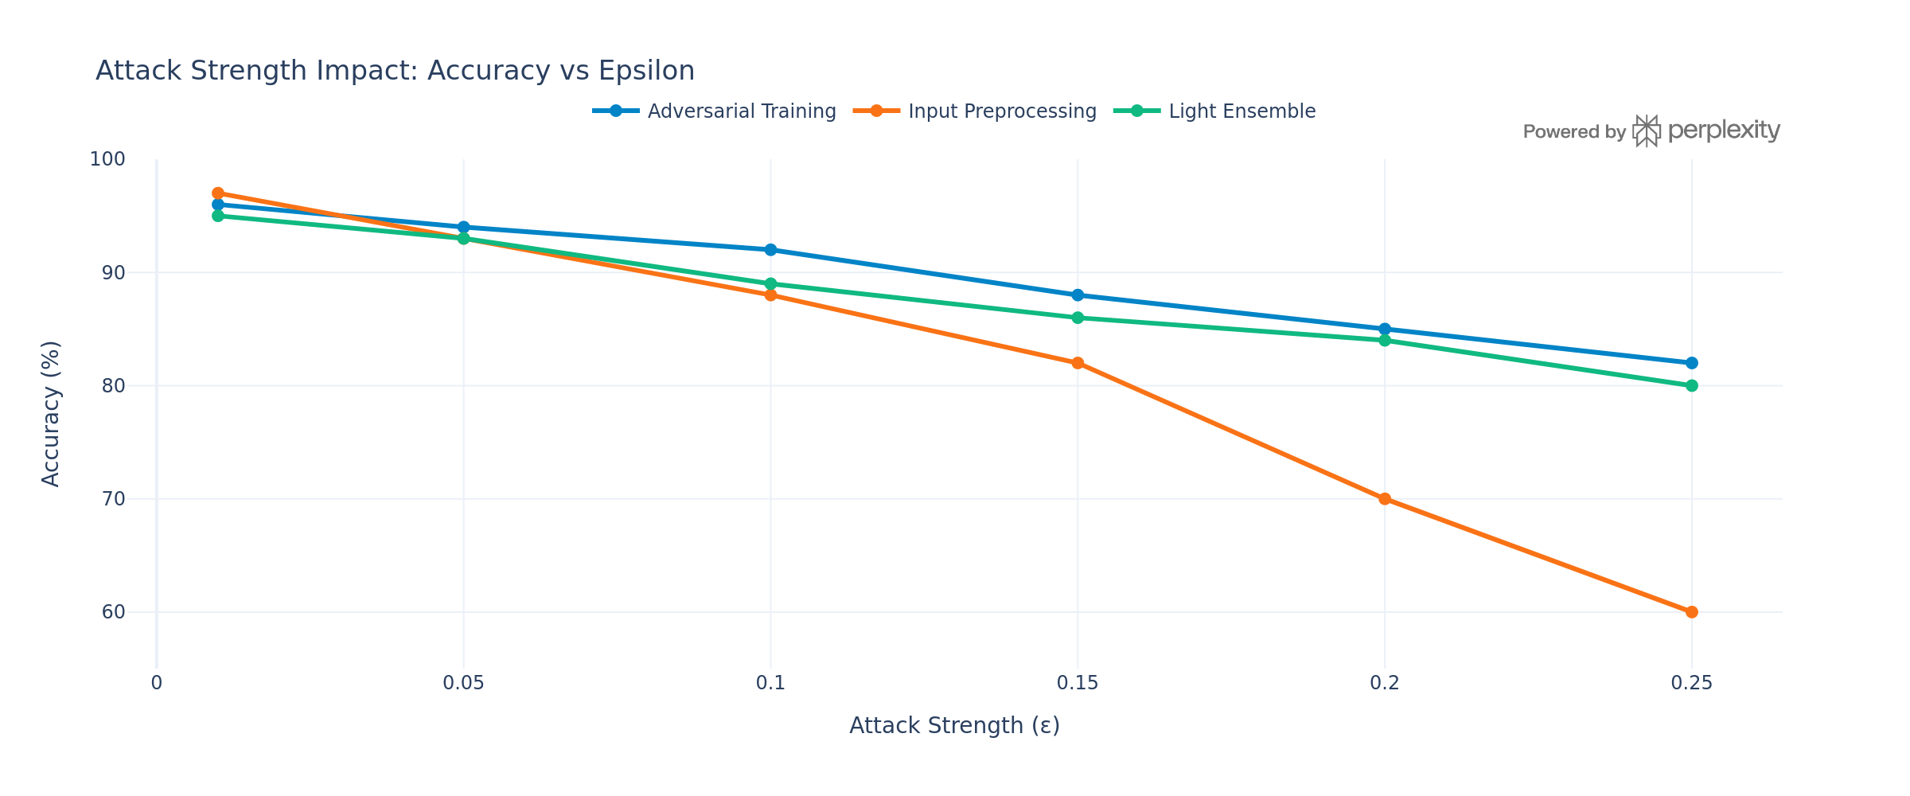
As attacks strengthen, defensive strategy choice becomes critical.

Slide 13
Objectives
Understand how adversarial attacks and data poisoning compromise AI models.
Evaluate existing attack types, mitigation strategies, and defense frameworks.
Design an adaptive, multi-layered defense model integrating risk-based and ensemble techniques.
Enhance AI resilience through self-correcting and continuous monitoring mechanisms.
Promote standardized benchmarks, prevention-focused methods, and collaboration in adversarial ML research.

Slide 14
References
Vassilev, A., Oprea, A., Fordyce, A., Anderson, H., Davies, X., & Hamin, M.Adversarial Machine Learning: A Taxonomy and Terminology of Attacks and Mitigations.NIST, 2024..
2. Bena, N., Anisetti, M., Damiani, E., Yeun, C. Y., & Ardagna, C. A.Protecting Machine Learning from Poisoning Attacks: A Risk-Based Approach.Journal of Information Security and Applications, 2025
3. Pawlicki, M., Pawlicka, A., Kozik, R., & Choraś, M.Survey on Adversarial Attacks and Defenses in Deep Learning.Applied Sciences, 2024
4. Ndayipfukamiye, D., Ding, X., Sarwatt, D., Philipo, C., & Ning, H.A Systematic Review of GAN-based Adversarial Attacks and Defenses in Cybersecurity.IEEE Access, 2025.
5. Ndayipfukamiye, D., Ding, X., Sarwatt, D., Philipo, C., & Ning, H.A Systematic Review of GAN-based Adversarial Attacks and Defenses in Cybersecurity.IEEE Access, 2024
6. Muthalagu, R., Malik, R., & Pawar, S.Adversarial Training and Abstract Interpretation for Robust Malware Detection.Computers & Security, 2023.

Slide 15
Thank You

